Slide 1
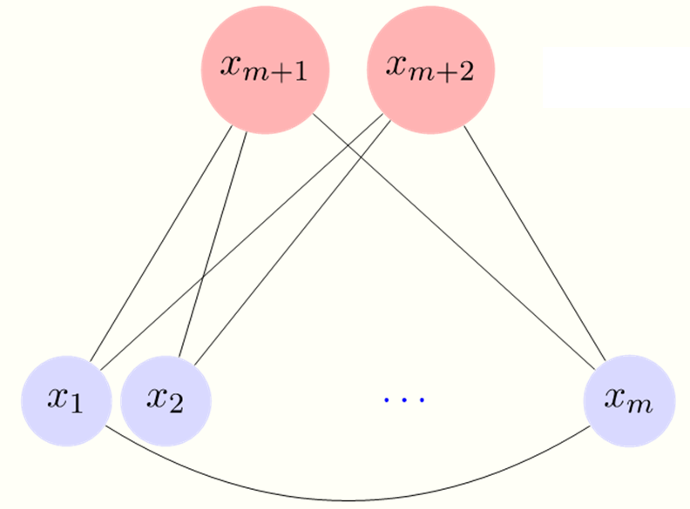
Sparse plus low-rank graphical models identiﬁcation in neuroimaging time series
Chulalongkorn University
Bangkok, Thailand – October 11, 2016
R. Liégeois¹, B. Mishra², M. Zorzi³, and R. Sepulchre⁴, and T. Yeo¹
¹Singapore Institute for Neurotechnology (SINAPSE), University of Singapore, Singapore. ²Department of Electrical Engineering and Computer Science, University of Liège, Belgium. ³Department of Information Engineering, University of Padova, Italy. ⁴Department of Engineering, Trumpington Street, University of Cambridge, United Kingdom.

Slide 2
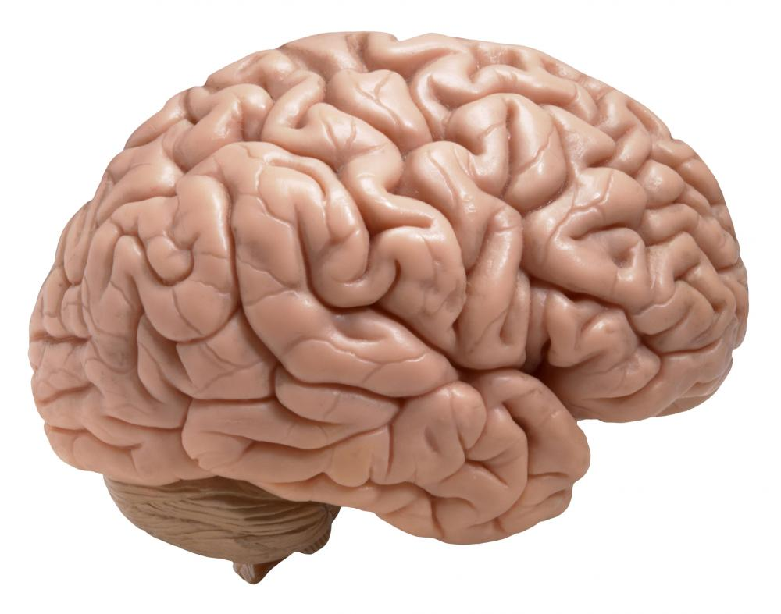
Introduction: functional information
Functional data (e.g. fMRI, EEG)
Functional connectivity (FC)
“Statistical dependence between two time series” (Friston, 2011).
FC matrix
Intensity in different ROIs
ROIs
Classically measured by the correlation between time series.
Time
ROIs

Slide 3
Introduction: motivating limitation
Functional data (fMRI)
FC measured by the correlation
FC matrix
ROI
ROI
Time (N points)
ROI
ROI
N points
FC measured by the correlation does not take the temporal information into account
“Static” approach

Slide 5
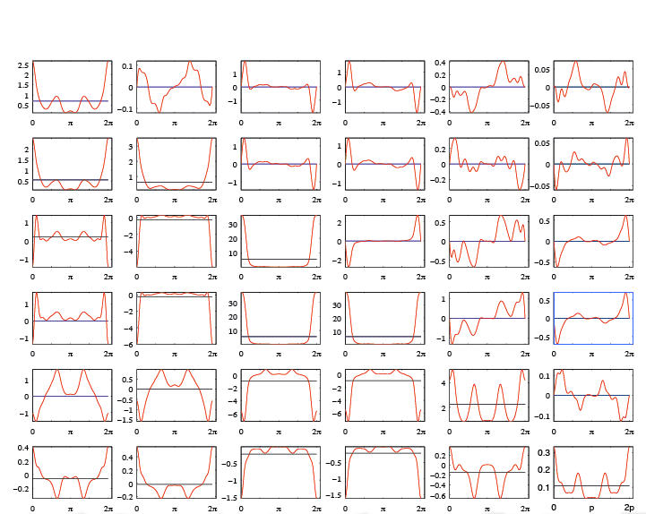
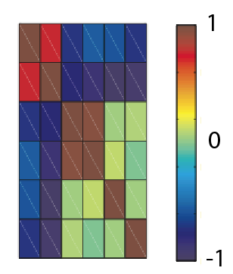
Static versus dynamic models
Starting from N observations :
Static models consider these observations as N realizations of a centered gaussian variable X entirely characterized by:
Dynamic models consider these observations as one realization of a centered gaussian process X_{t} entirely characterized by:
Functional data (fMRI)
ROI 1
ROI 2
or
ROI m
(N) samples

Slide 6
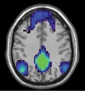
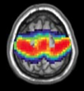
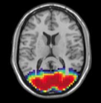
Low-rank approximation of functional connectivity
In static models, FC is measured by the correlation matrix of the data denoted Σ_{m,m}
where m can be large we need prior information about “where to look”.
One general framework to explore this is to compute a low-rank approximation of Σ_{m,m}:
Advantages
Reduce dimension
Easy neurological interpretation as the superposition of different networks:
DMN
SM
VIS
where:
c_{i} of size (m,1) is the i^{th} component,
α_{i} is the weight of the i^{th} component,
r is the rank of the approximation, or number of components.
Robust across subjects
Drawback
It is static

Slide 7
Our approach: graphical models
Definition
Interpretation of Φ⁻¹
A graphical model is defined by a set of nodes x={x₁,…,x_{n}} and edges such that there is an edge between x_{k} and x_{l} if and only if:
Φ(k,l) encodes statistical dependencies between x_{k} and x_{l} whereas Φ⁻¹(k,l) encodes statistical dependencies between x_{k} and x_{l} conditioned on all the other variables:
The corresponding graphical model is:

Slide 8
Which graphical model for fMRI data ?
fMRI data
Which graphical model ?
ROI 1
(2) Latent variables
ROI 2
ROI m
Manifest variables
Time
We want:
The manifest (observed) variables to be modeled as the superposition of few latent (hidden) variables.
We w
Few connections within the manifest variables.
We w
No connections within the latent variables.

Slide 9
Structure of Φ⁻¹
Considering:
l latent variables
m manifest variables (m>>l)
,
we have:
The identified inverse power spectral density should be the sum of a sparse and a low-rank term
encodes the weight of each latent variable in each manifest variable

Slide 10
Definition of latent components
The i^{th} latent component of a graphical model, with i ≤ l, is the i^{th} column of .
It is denoted γ_{i,.}(θ),
It is a function of θ when p>0.
When m is too large, and for p=1, we define two contributions: γ₀ = γ(θ=0) and γ_{π} = γ(θ=π).

Slide 11
Corresponding optimization problem
The corresponding optimization is a regularized covariance selection problem (Zorzi and Sepulchre, 2015):
where:
m is the number of (manifest) variables,
p is the number of lags considered,
C is a matrix containing the sample covariance lags ,
the weighting parameters γ>0 and λ>0 enforce sparse S and low-rank L.
Solved using the Alternating Direction Method of Multipliers (ADMM - Boyd et al., 2011) in order to decouple the sparse and low-rank constraints:
the sparse constraint reduces to a separate problem solved in Songsiri and Vandenberghe, 2010
the low-rank constraints reduces to a projection onto the cone of positive semidefinite matrices

Slide 12
Overview of our algorithm
ADMM for sparse plus low-rank inverse power spectral density estimation. Initialize Z⁰, Y⁰, M⁰; set ρ > 0; and successively update variables as follows:
where:
Y and Z are the dual variables,
M is the decoupling variable,
C₁ is a set corresponding to the sparsity constraint defined in Songsiri and Vandenberghe (2010),
C₂ is the cone of positive semidefinite matrices (low-rank constraint)
The Matlab code for the algorithm is available from the webpage http://www.montefiore.ulg.ac.be/~rliegeois/.

Slide 14
Dataset n°1
Synthetic dataset composed of time courses in 7 nodes organized in two coupled clusters, sampled at three different rates: original, T₁, and T₂ :
For each of the three datasets, and for p=0 (static case) and p=1 (dynamic case), we identify the optimal S+L model and corresponding latent components.

Slide 15
Results on dataset n°1
In the static case, we identify two latent components, similar for each dataset.
In the dynamic case, one single latent component is identified that also encodes spectral information of the dataset.

Slide 16
Dataset n°2
17 healthy volunteers
Functional (fMRI) data acquired during rest in 90 regions of interest
If principal component analysis is applied, we recover the three following networks:
For each subject, we compute the optimal S+L model and corresponding latent components for p=1 (dynamic case).

Slide 17
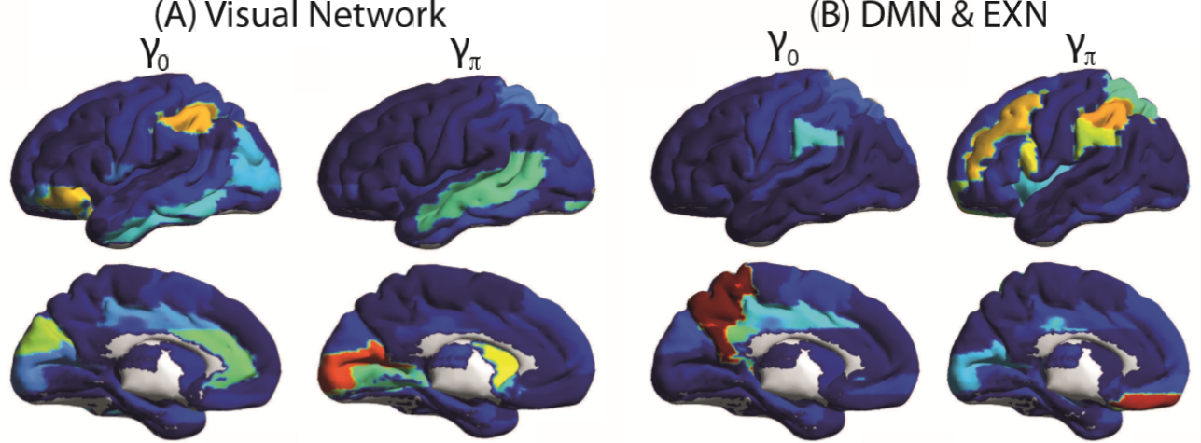
Results on dataset n°2
Among the 10 to 12 latent components identified:
the Visual network is identified in 14 out of 17 subjects in a single latent component,
the DMN and EXN are identified in 12 out of 17 subjects, almost each time coupled to each other within a same latent component.

Slide 18
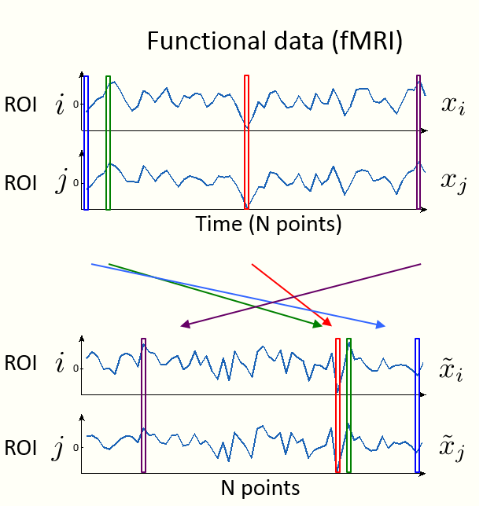
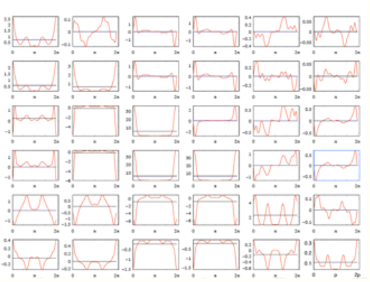
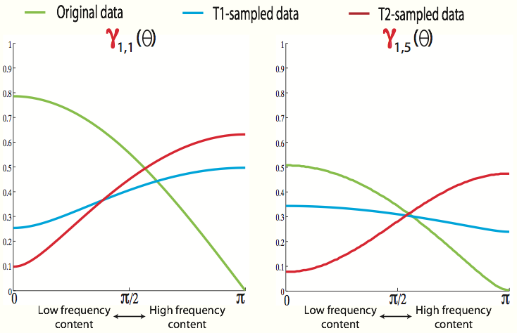
Take-home messages
1. The temporal/ordering information is not taken into account in static measures of
connectivity.
2. Dynamical models of connectivity generalize classical (static) measures of connectivity.
3. Latent components of graphical models capture a spatio-temporal subspace of variation.

Slide 19
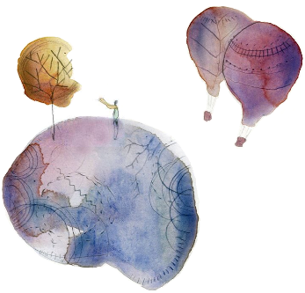
Thank you

Slide 20
Corresponding optimization problem
The corresponding optimization is a regularized covariance selection problem (Zorzi and Sepulchre, 2015):
where:
m is the number of (manifest) variables,
p is the number of lags considered,
C is a matrix containing the sample covariance lags ,
the weighting parameters γ>0 and λ>0 enforce sparse S and low-rank L.
Solved using the Alternating Direction Method of Multipliers (ADMM - Boyd et al., 2011) in order to decouple the sparse and low-rank constraints:
the sparse constraint reduces to a separate problem solved in Songsiri and Vandenberghe, 2010
the low-rank constraints is detailed in Liégeois et al., CDC 2015.
The Matlab implementation of the algorithm is available from the webpage http://www.montefiore.ulg.ac.be/~rliegeois/.

Slide 21
Overview of our algorithm
Problem to be solved:
Problem 1: h is convex but non-smooth.
(Partial) Solution: when there is only the sparsity contraint, solve on the corresponding dual problem (Songsiri and Vandenberghe, 2010).
Problem 2: how to include the low-rank constraint ?
Solution: use the Alternating Direction Method of Multipliers (ADMM - Boyd et al., 2011) in order to decouple sparse and low-rank constraints (Liégeois et al., 2015).

Slide 22
Overview of our algorithm
ADMM for sparse plus low-rank inverse power spectral density estimation. Initialize Z⁰, Y⁰, M⁰; set ρ > 0; and successively update variables as follows:
where:
Y and Z are the dual variables,
M is the decoupling variable,
C₁ is a set corresponding to the sparsity constraint defined in Songsiri and Vandenberghe (2010),
C₂ is a set corresponding to the low-rank constraint (Liégeois et al., CDC 2015).
The Matlab implementation of the algorithm is available from the webpage http://www.montefiore.ulg.ac.be/~rliegeois/.

Slide 23
Convergence of ADMM

Slide 24
Application of S+L identification on synthetic data

Slide 25
Interaction graphs in neuroimaging data
B
Frontal
Occipital
Temporal

Slide 26
Generative model: Hopfield

Slide 27
Dataset n°2
Synthetic dataset composed of time courses in 7 nodes organized in two uncoupled clusters, sampled at three different rates: original, T₁, and T₂ :
For each of the three datasets, and for p=0 (static case) and p=1 (dynamic case), we identify the optimal S+L model and corresponding latent components.

Slide 28
Results on dataset n°2
In the static case, we identify two latent components, similar for each dataset.
In the dynamic case, two latent components are identified because the spectral properties of each cluster are different (uncoupled oscillators).

